Slide 1
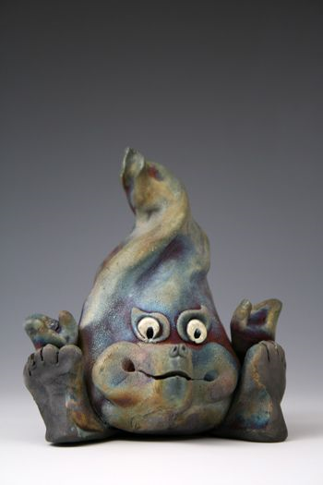
Kiln Gods
Guardians of the Kiln
Barbara J. Cornett

Slide 2
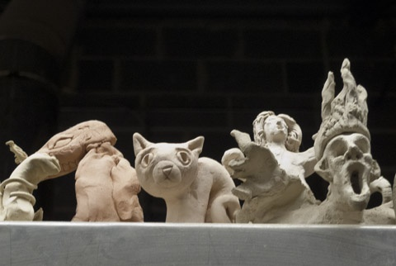
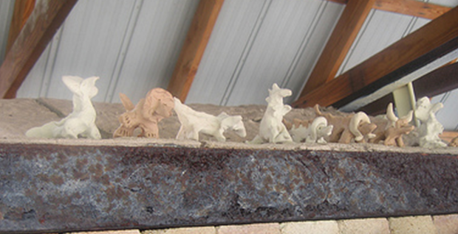
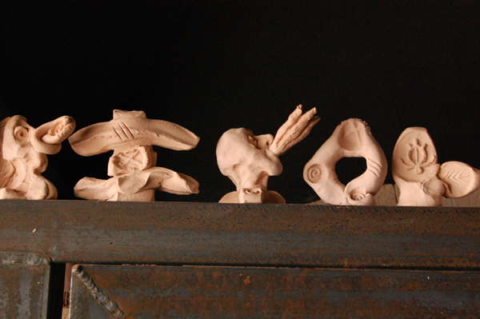
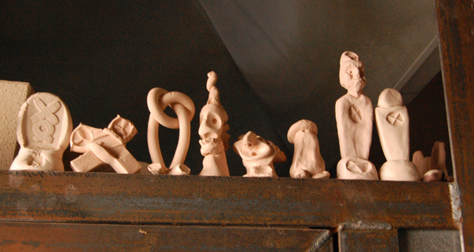
Kiln gods are traditionally made out of raw or fired clay and placed over the entrance to the kiln.

Slide 3
Why Make a Kiln God?
In Playing with fire and kiln Gods, Martie Geiger-Ho explains why she is so driven to make ceramics.
“There are many reasons why American ceramists make kiln gods, however, I believe that, like myself, most ceramists make kiln guardians as a means for helping to relieve stress and to dispel the anxiety caused by the difficulty of trying to control the outcome of a ceramic firing. For me the process of ceramics has always seemed magical and I have never had a firing I could totally control, including electric kiln firings. This seems to be the case for most ceramists and I imagine that this is why so many different cultures from around the world have developed some sort of kiln god mythology as a way of coping with the insecurities that come with making and firing ceramics.”

Slide 4
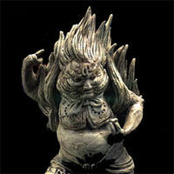
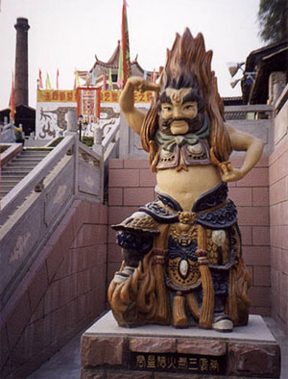
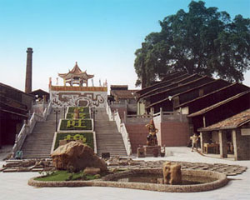
The Fire God of the South Wind Region, Shiwan, Foshan, Guangdong, China
The "Fire God of the South Wind Region" guards the oldest continuously fired kiln in China. The Nanfeng (south wind) Ancient Kiln is approximately 500 years old and is located in Shiwan, Foshan, Guangdong, China. This sculpture was created by Master Mei for the Millennium Firing of the Nanfeng climbing hill kiln in 2000. Master Mei created this sculpture from his own imagination. The sculpture celebrates the southern Chinese tradition of honoring the stove God for a successful kiln firing.

Slide 5
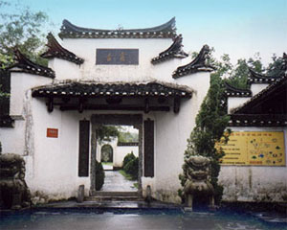
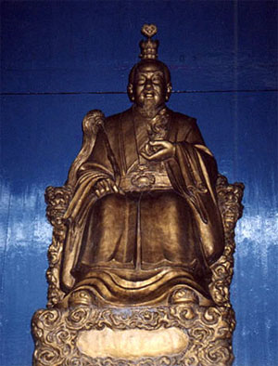
Feng Huo Hsien, Jingdezhen, China
"Feng Huo Hsien" is the reigning kiln god at the Blessed Potters' Temple located at the Ancient Kiln and Porcelain Factory site in Jingdezhen, China. Dressed in the manner of a Toaist priest, Feng Huo Hsien, or "The Genius of The Fire Blast" as he is called in English, presides over a court of eight other almost life-size kiln guardian attendents.

Slide 6
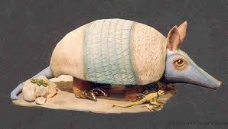
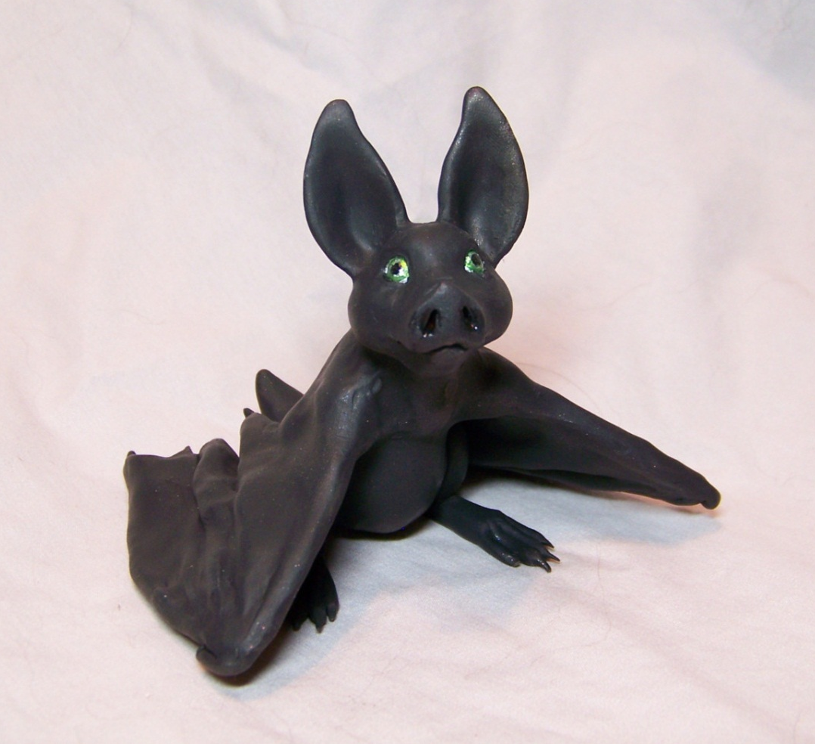
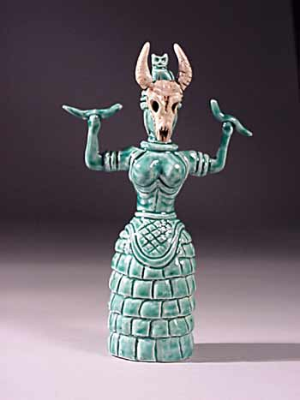
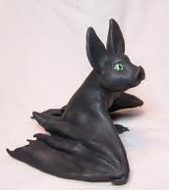
Kiln god
Some examples:

Slide 7
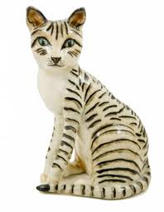
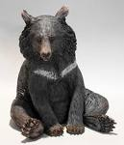
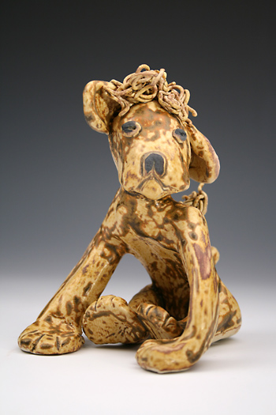
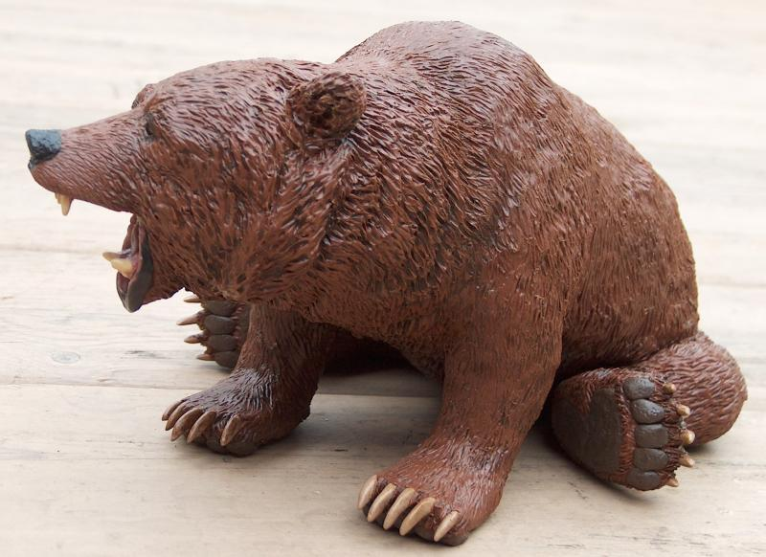
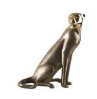
Kiln god
Some examples:

Slide 8
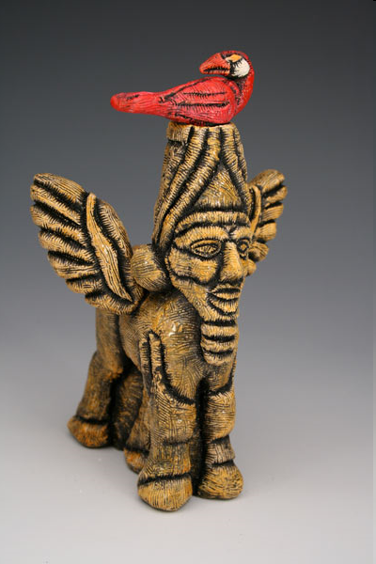
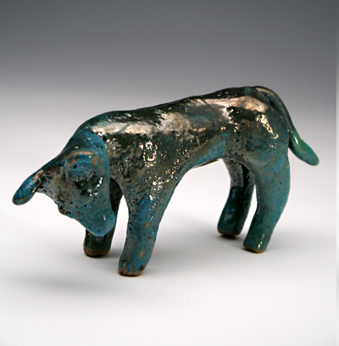
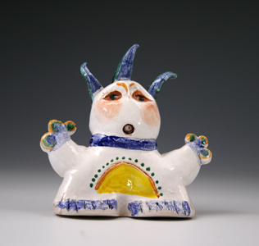
Kiln gods from National Show
Jordan Hatcher
Brenda S. Martinez
Bryan Hiveley

Slide 9
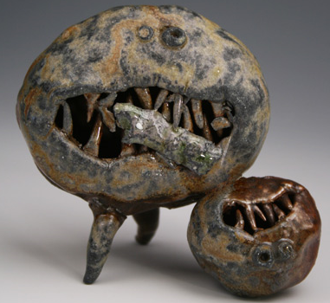
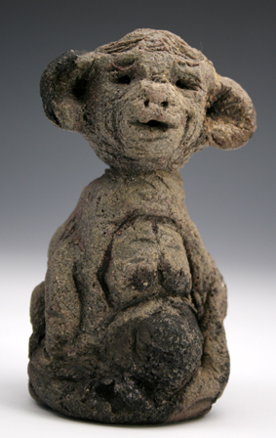
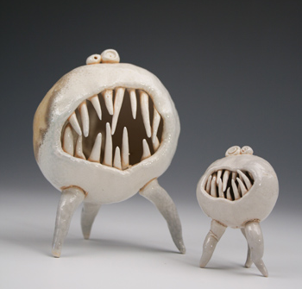
Kiln gods from National Show
Dave Melnick
Lisa Quintero

Slide 10
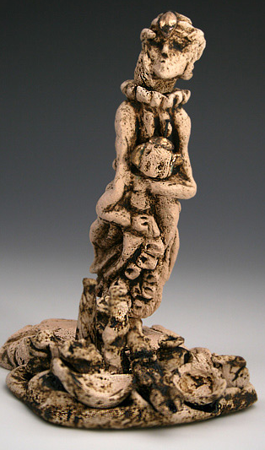
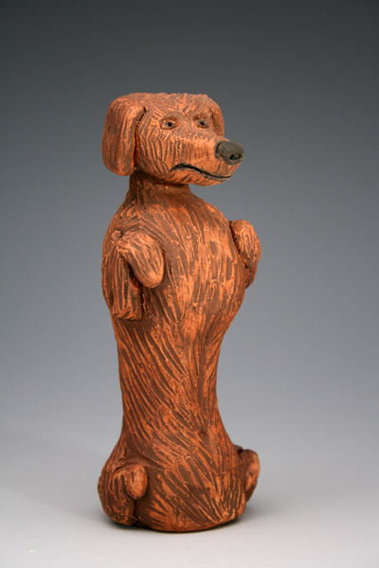
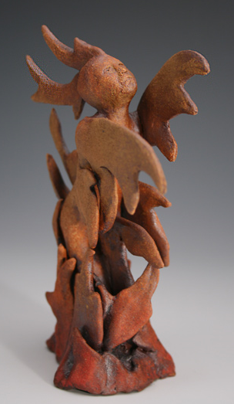
Kiln gods from National Show
Bertie Smith
Holli Barnes
Carmen Bond

Slide 11
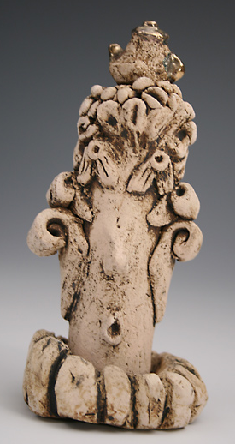
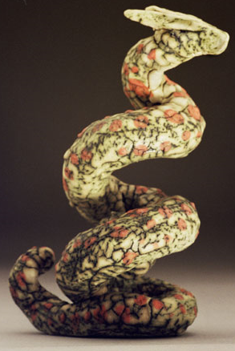
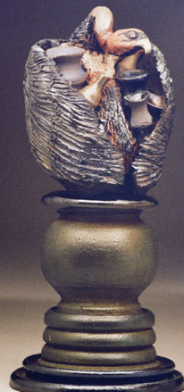
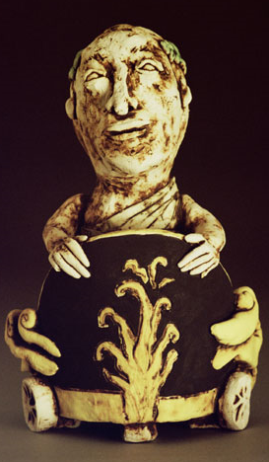
Kiln gods from National Show

Slide 12
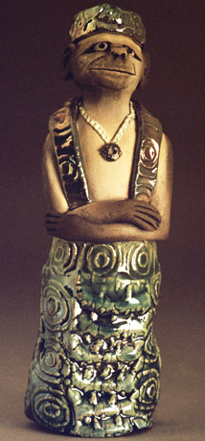
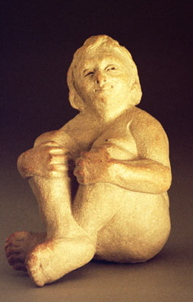
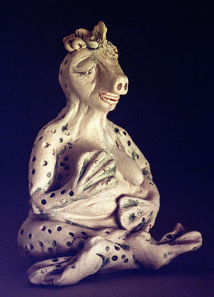
Kiln gods from National Show

Slide 13
Assignment:
Create your very own Kiln God to protect our kiln this semester!
Things to consider:
  What types of images come to mind when you think about guardians and protection?
    Create a list in your sketchbook.
    Find some references images and place them in your book with your list.
  How can this research help you create your own unique design?
    Use what you’ve gathered in your book to create sketches for your design.
  Sketch:
    Create at least 2 different sketches
    Show two views of your design.

Slide 14
Requirements:
Your Kiln God needs to:
  be 3 dimensional
  be at least 2 inches wide and 3 inches tall
  be a creature of some sort
  stand without support

Slide 15
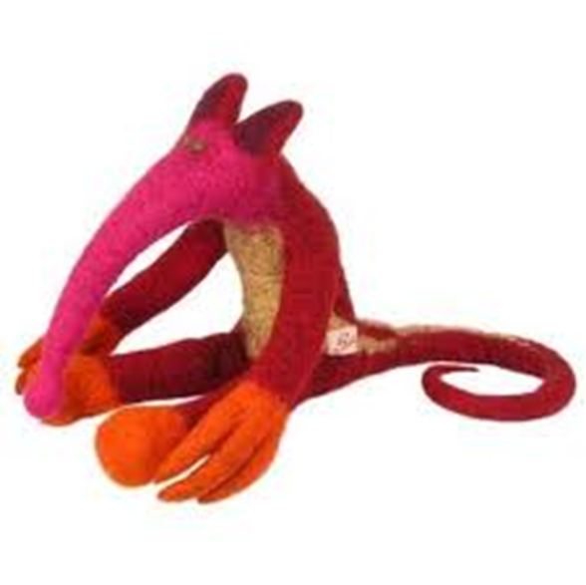
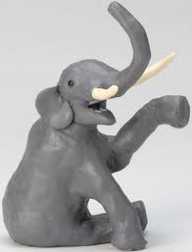
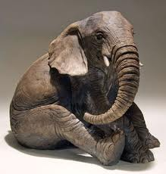
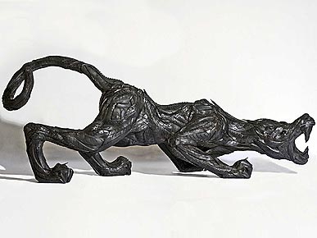
Kiln god
BE CAREFUL!!!
THIN PIECES BREAK!!!

